Slide 1
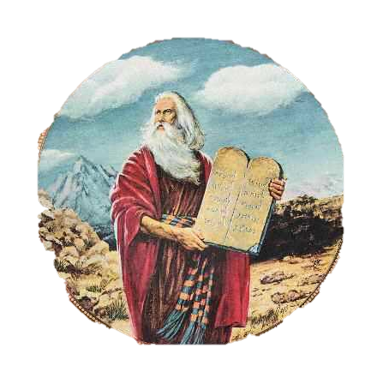
The 10 Commandments of Beekeeping (adapted from Keith Delaplane, 1993)

Slide 2
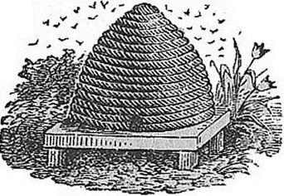
I. Thou shalt use only standard beekeeping equipment.
Modern hives with movable frames are the standard.
Movable frames are required to provide access for inspections.
Modern hives do not require destruction of a hive to gain access to the honey as with skeps.

Slide 3
II. Thou shalt be considerate of non-beekeeping neighbors.
You don’t want your bees stinging neighbors.
Keep hives away from people, but especially children.
Alert your neighbors as to the presence of your hives.
Provide your bees with water.
Educate your neighbors and sweeten situations with honey.

Slide 4
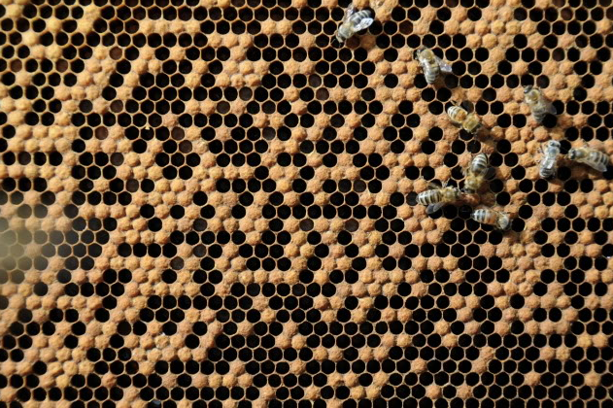
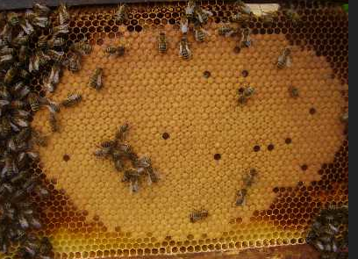
III. Thou shalt requeen regularly.
Maximize your production with good queens.
Goods queens also help to suppress swarming because swarms can frighten your neighbors.

Slide 5
IV. Thou shalt control diseases and pests.
Get to know pests and diseases.
Be particularly careful with foulbrood.
Get to know your medications and use them only when necessary.
Medications are not a substitute for good beekeeping practices.

Slide 6
V. Thou shalt maximize colony populations before main nectar flow.
In order to make beekeeping sustainable, build up the colony prior to the nectar flow and not on the nectar flow.
Feed nectar and pollen substitutes early.
Control swarming to the greatest extent possible.

Slide 7
VI. Thou shalt super colonies according to their needs.
Adequate supering can encourage honey production as well as help to prevent swarming.
Honey is dehydrated nectar, and lots and lots of surface area is needed to drive off excess water.

Slide 8
VII. Thou shalt take pride in honey and other hive products.
Keep your hive and equipment clean, as well as all your beekeeping equipment such as your extractor.
Use multiple filtering to clean honey thoroughly.
Never sell or even give away honey with unsightly bits of contamination.
Package your products professionally.

Slide 9
VIII. Thou shalt protect thy beekeeping equipment.
When building hives, consider pilot holes, the best glues, and a good layer of paint.
Keep your hives off the ground by placing them on hive stands.
Protect your honey comb from destruction.
Store everything in a clean, dry space as necessary.

Slide 10
IX. Thou shalt help thy bees through the winter.
Use at least 2 full-size or 3 medium-size brood chambers for over wintering of bees.
Make certain you leave adequate honey in the hive at the end of the season.
Use entrance reducers in the fall and winter.
Pack your hives or otherwise protect them from direct winds.
Fee the bees as needed during colder times.

Slide 11
X. Thou shalt join and participate in a beekeeping association.
Beekeeping organizations can be very helpful to the new beekeeper.
Beekeeping associations also speak for the average beekeeper.
Also consider subscribing to beekeeping journals such as American Bee Journal, Bee Culture, and The Speedy Bee.

